Slide 1

From Code Villain to SPFx Hero: SPFx Best Practices for Sustainable Solutions
Dan Toft

Slide 2





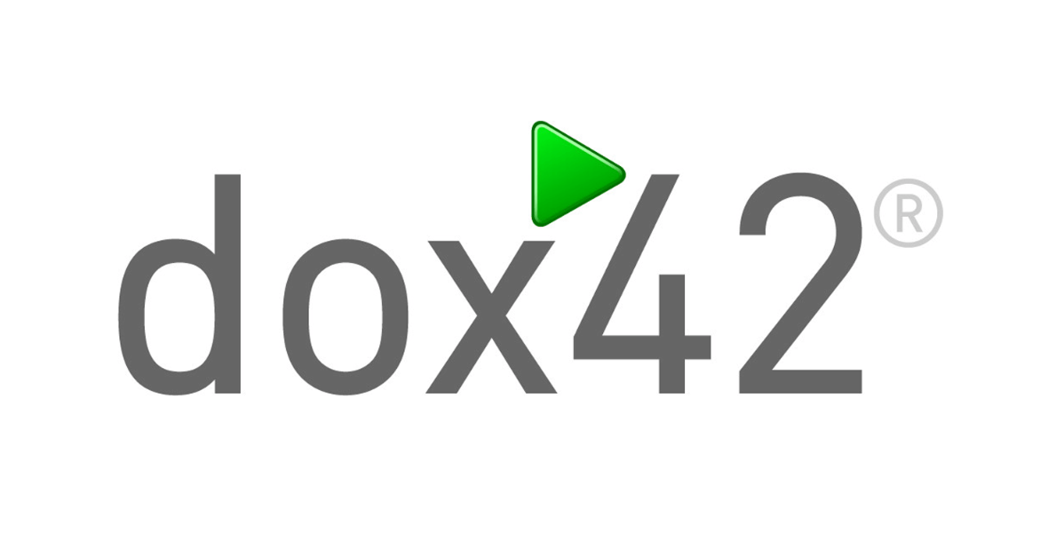













































































Premium Partner
Premium Sponsor
Technology Partner
Diamond Sponsor
Platinum Sponsor
Gold Sponsor
Silver Sponsor
Bronze Sponsor
Startup Silver
Startup Bronze
Startup Sponsor

Slide 3



Dan Toft
Microsoft 365 Dev & Enthusiast 🧑‍💻
Microsoft 365 developer since 2018
“Cloud native” developer ☁️
PnP Team Member
M365 Development & Graph MVP
Passionate about code & open-source
Based in Denmark 🇩🇰
SPFx geek

Slide 4




Demarcation
We will not be talking about React in this session, but you can use everything we see today WITH your React SPFx code
27.05.2025 12:00 Edin Kapic
Clean SPFx Code: How to Write Maintainable Client Components
27.05.2025 17:50
Derek Cash-Peterson
Introduction To Custom List Forms Using SPFx
28.05.2025 14:50
Don Kirkham
Power Up Your M365 Development Game: Embracing React Functional Components and Hooks
Notes:
I had a lot of thoughts in my notepad – but the agenda is already packed with cool stuff – check out these other sessions

Slide 5




Thank you to the amazing slide reviewers
Beau Cameron
M365 Practice Lead, Senior Principal Architect | Microsoft MVP
Encora Inc,
Laura Kokkarinen
Lead Architect, Software Development | Microsoft MVP
Sulava Oy
Julie Turner
Partner/CTO Sympraxis Consulting | Microsoft MVP
Sympraxis Consulting
Jeppe Spanggaard
Microsoft 365 & SharePoint Specialist
Evobis ApS
Notes:
Code is opinionated, I tried to gather opinions from some of the people I know have been writing code for longer than me
These folks have looked over the slides, provided feedback, these are still my opinions, but weighed with what these amazing folks have added

Slide 6

Disclaimer
This session is highly opinionated, as is all code.
You might not agree 100% with my way of solving a certain problem, and that is very much the intention, this session is designed to make you think about how, and more importantly – WHY you solve a problem in a certain way, because if you do it ”because that’s how I’ve always done it”, you probably know deep down that there might be a better way, and I want you to be curios, that’s the main goal of this session
If you don’t leave here with a new take on anything, I’m sorry

Slide 7
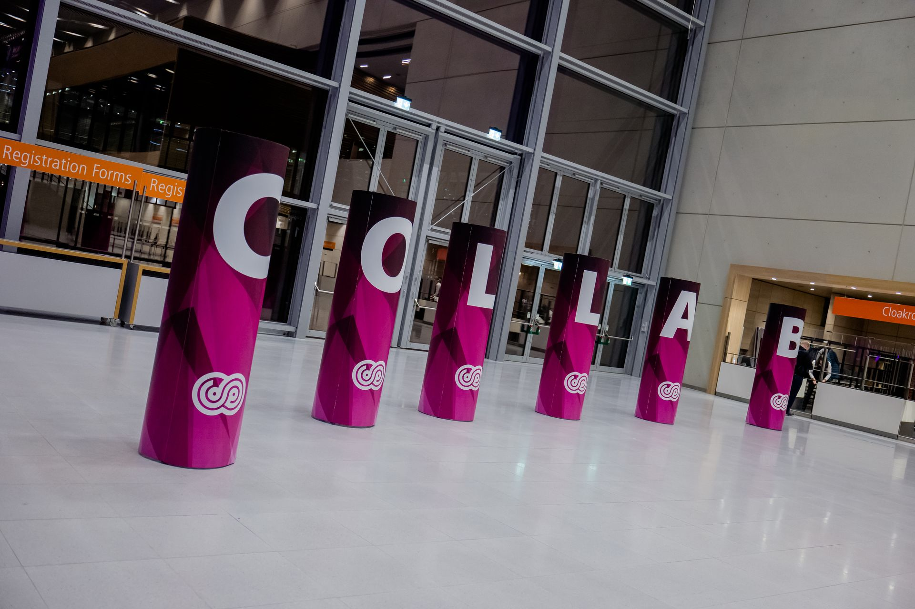
Martin Fowler
“Any fool can write code that a computer can understand. Good programmers write code that humans can understand”
Notes:
Famous for writing books on software development
Original signers of Manifesto for Agile Software Development
Says a lot about code, it can be written in a million different ways

Slide 8
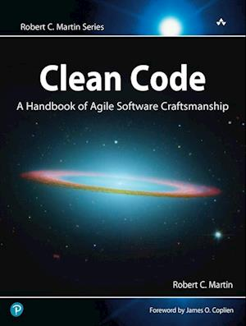
Clean code
The book that changes perspectives
Disclaimer:
Author (Uncle Bob) is widely regarded as an a**hole, and a grumpy old man
It contradicts itself on more than one occasion
It’s is close to 20 years old
My colleagues would say it’s a lot like me
Notes:
In many ways … the book is like me 😅 Written in a tone of “this is the only true way to do X” – despite foreword having different tone
IMO – Not for beginners, but really good for Juniors, who’re capable of picking through it, and choosing what they find useful
Really good at getting you to start thinking about better ways to write code Recently reread it, and now again with different eyes

Slide 9


Alternative recommendation
"A Philosophy of Software Design”
John Ousterhout.
“The Art of Readable Code”
Trevor Foucher, Dustin Boswell
Notes:
Camera in top right, get out your phones and get a picture Both come highly recommend, and are both newer than clean code
"A Philosophy of Software Design" by John Ousterhout. (2018 – 10 years never)
“The Art of Readable Code” - Trevor Foucher, Dustin Boswell (2011 – 3 years never)

Slide 10
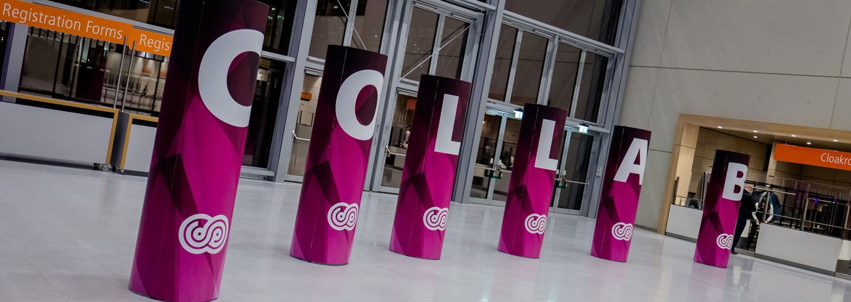
Clean Code
Why does it matter
Notes:
If my solution works, what is the problem?

Slide 11
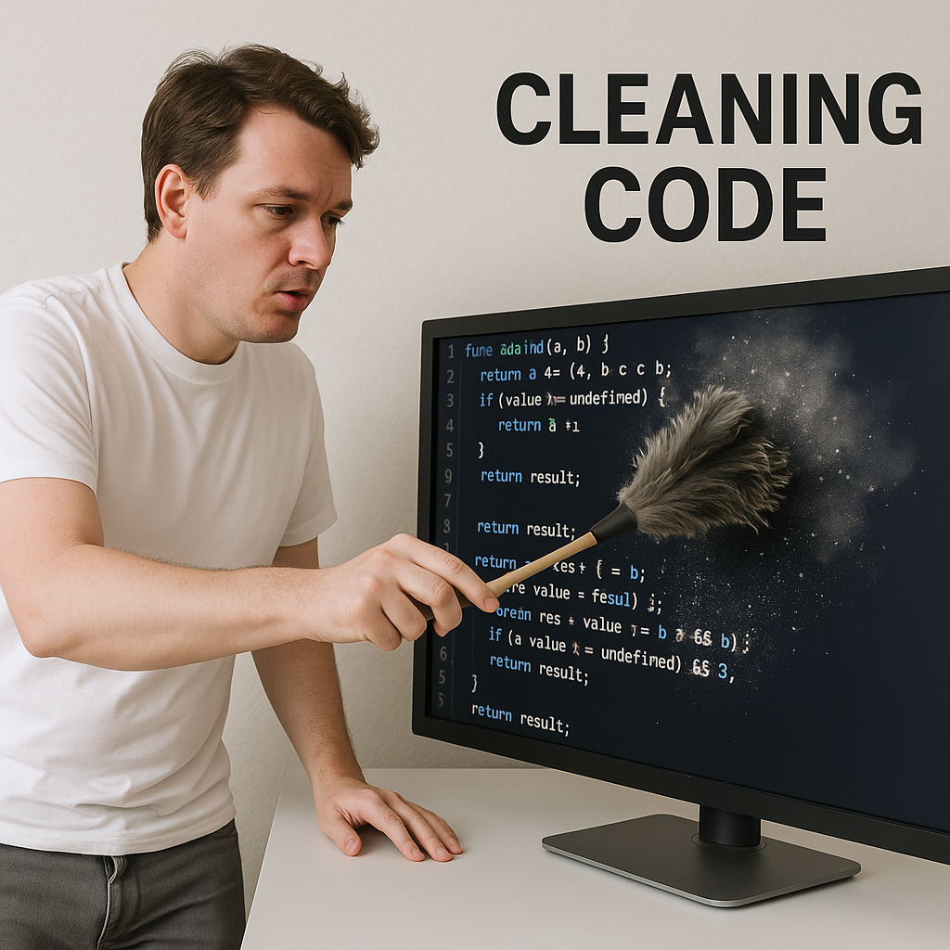
Clean Code - Why does it matter
Clean code is:
Maintainable
Also, by people who didn’t write the code
Easily extensible
“Self-explanatory”
Reads the way it executes
No unintended side effects
Notes:
Even a fresh new developer should be able to read and understand the code
Implementing new changes shouldn’t be scary
The code should “read like a poem” – which I don’t agree with because I don’t understand poems
It should just be readable

Slide 12
Code smell
What is bad code?
Notes:
When we talk about bad code, we often talk about code smell …. But what is code smell

Slide 13
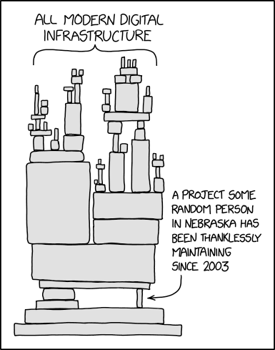
Common code smells
It’s hard to change
Fragile - Small changes cascade breaking effects
Immobile – Code cannot be reused without high risk
Opacity – the code is hard to understand
Full of bad comments
“Orange”
Untyped
Long methods
Notes:
In general, bad code is the code you write once, and then don’t know how to maintain later
”But I don’t know how to write clean code”

Slide 14
The cycle of keeping code clean
Write code quickly
Validate code works
Clean the code
Validate it still works
Notes:
No one writes stink free code in the first attempt
Repeat as many times as needed
…One smell we didn’t cover before…

Slide 15
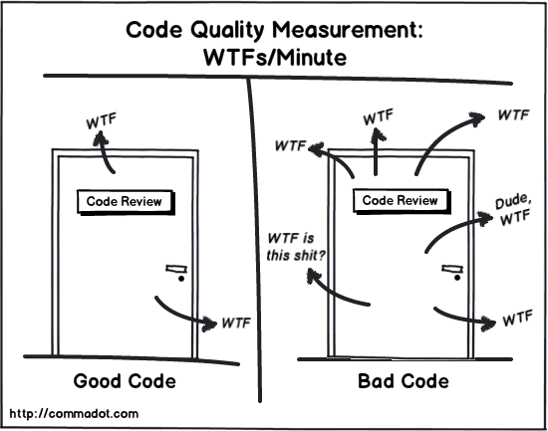
Code Smell – Repetition
Methods that look alike can almost always be simplified into something more “coherent”
Repetition also means potentially making the same mistake over and over
Notes:
The worst code smell you can have If code repeats itself; it means that making even a small change require a lot of changes
I had a teacher that used to say “Wisdom's way is repetition”
Don’t repeat yourself three times - Edin

Slide 16
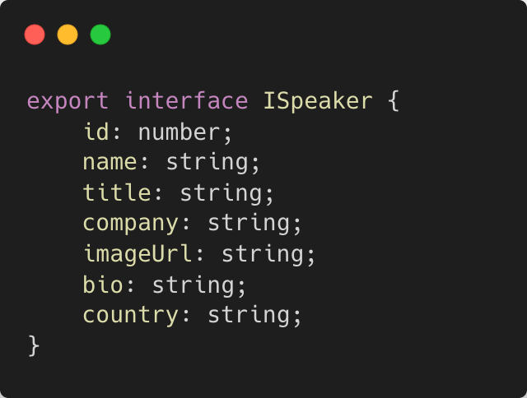
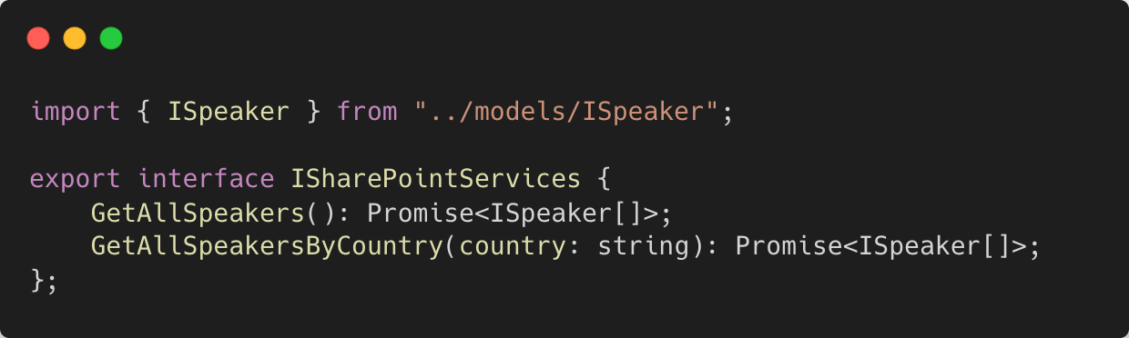
Code repetition
Notes:
Simple interfaces that must be implemented

Slide 17
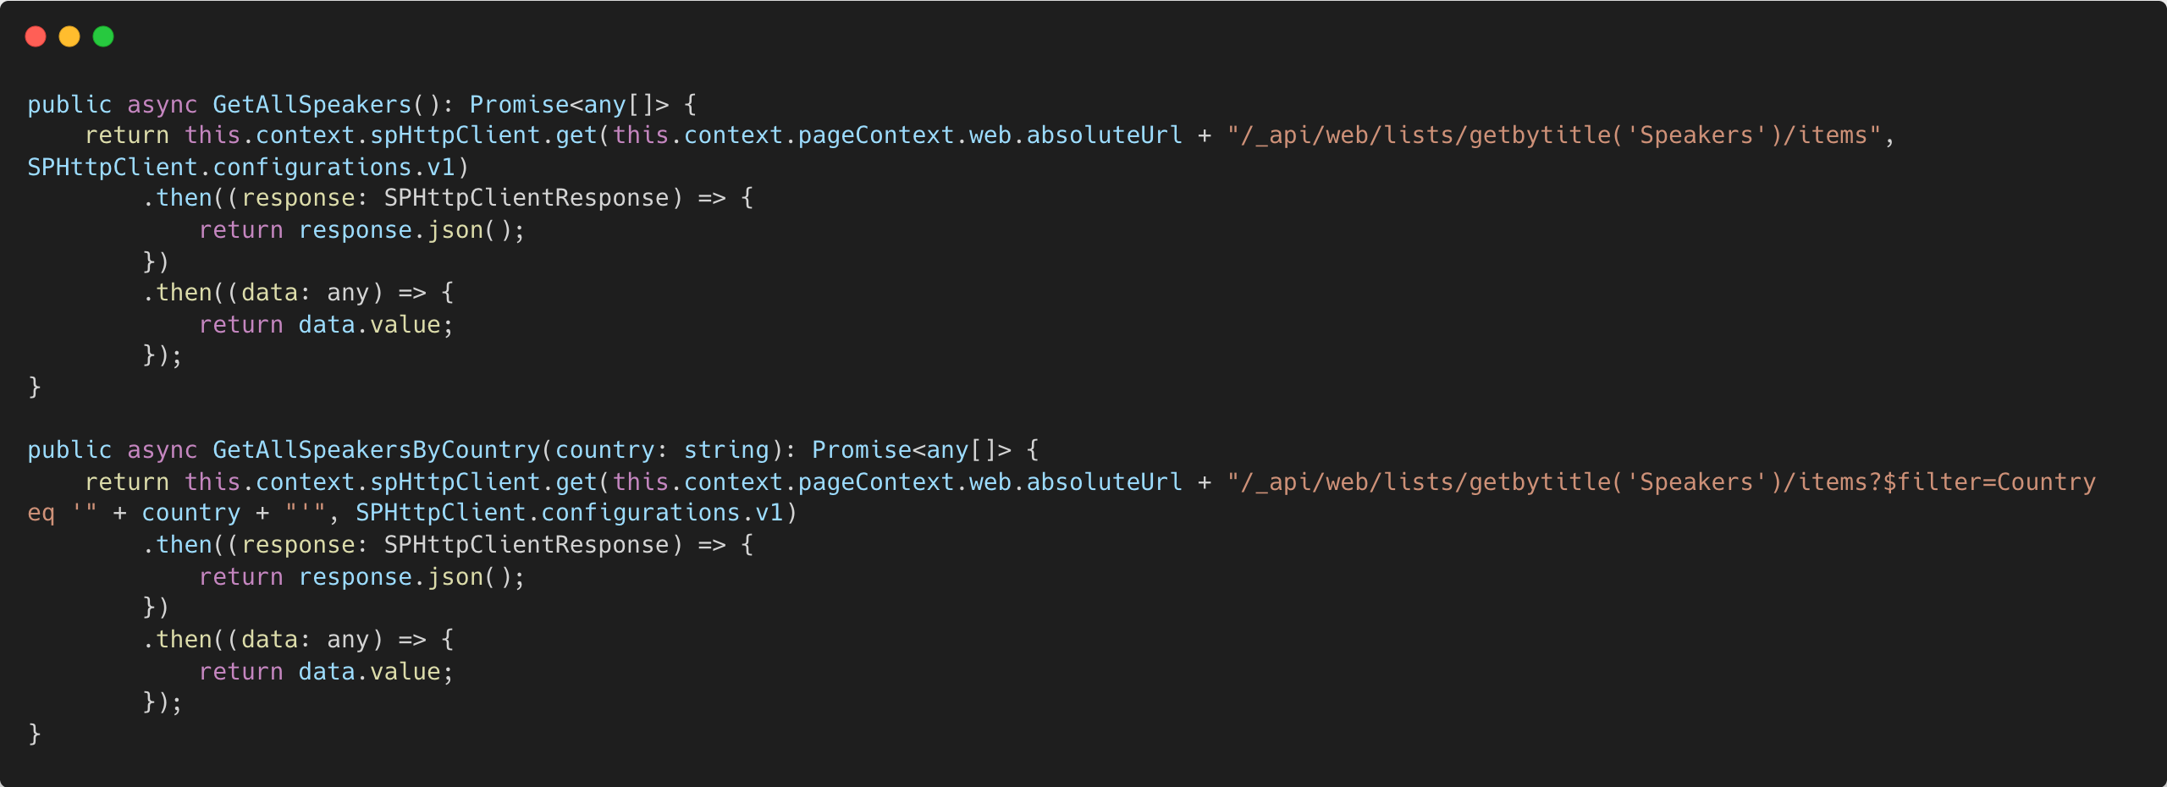
The Github Copilot implementation
Notes:
Why is this bad?
Two methods that have a lot of very similar code
A lot of repetition
Usage of type any
Not actually valid signature, I still need to parse the JSON, and return the d.results

Slide 18
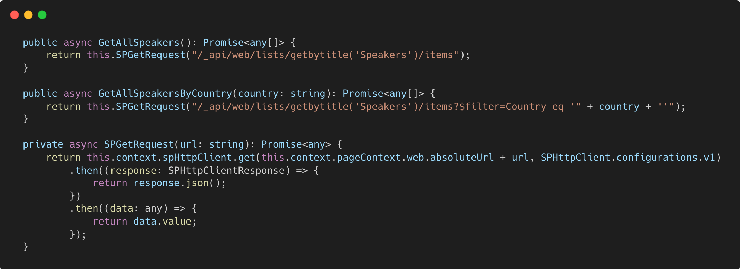
“Trim the fat”
Notes:
If we now wanted to implement paging it would only be a single place to implement
Would still not work, as we’re not looking for data.value, but rather data.d.results
Url encoding – what happens when a country has a &

Slide 19
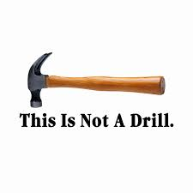
Not levering the language you’re using
Using type “any”
Most programing language have native tools to handle many common ”problems”
URL Encoding
Date formatting
Number formatting
String concatenation
Notes:
All modern languages have built in handling for common things
URL encoding, Date formatting (you don’t need moment.js, date-fns or anything else)
It’s just about knowing where to look

Slide 20
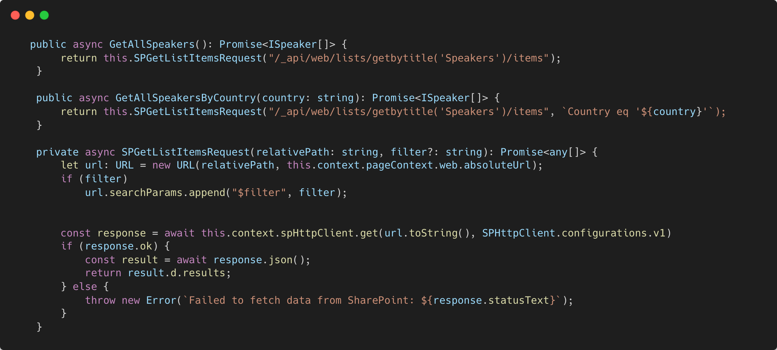
Make use of the URL object in JavaScript
Notes:
Make use of the URL object in JavaScript, to ensure proper encoding of your query String concatenation is the second paramater
Returning an array of items, not just the entire response body
Async away over then.then.

Slide 21
Realize – you’re probably not the first person to face the issue
Common knowledge sources
Design patterns
SDKs
Blog posts
Less common knowledge sources
Microsoft Learn
Literally any official documentation
aka.ms/community/home
PnP Reusable Controls
PnP Reusable property pane controls
PnPjs
Camljs
Notes:
Worst mistake I made in all of this
We developers don’t like to read docs
Sometimes other devs have read them for us … and written just what we need
PnPjs Next slide

Slide 22
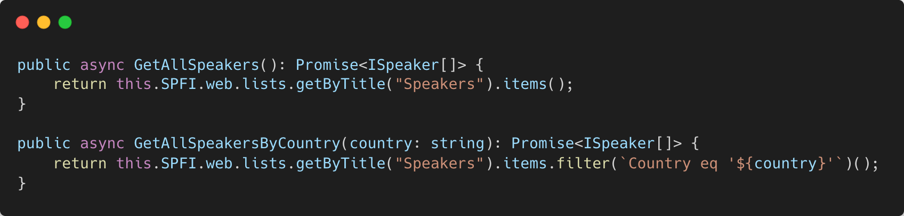
PnPjs – make working with SharePoint APIs a breeze
Notes:
This is very clean – all our code has been compressed to just a few lines
Yes there’s still some repetition, but worse yet, there’s repeating orange code

Slide 23

(Untamed) Orange is the new bad
Orange code is fragile code
Refactoring is next to impossible
Strings should really be using localization tools
Variables should be “stationary”/"static" and exist only in one place
Notes:
Orange code is fragile – it’s like your IDE giving you a warning
Find and replace … really?
Next slide is enums

Slide 24
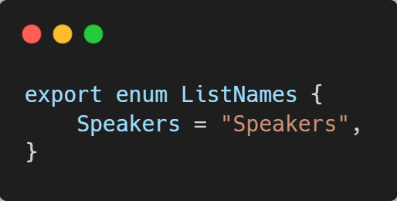
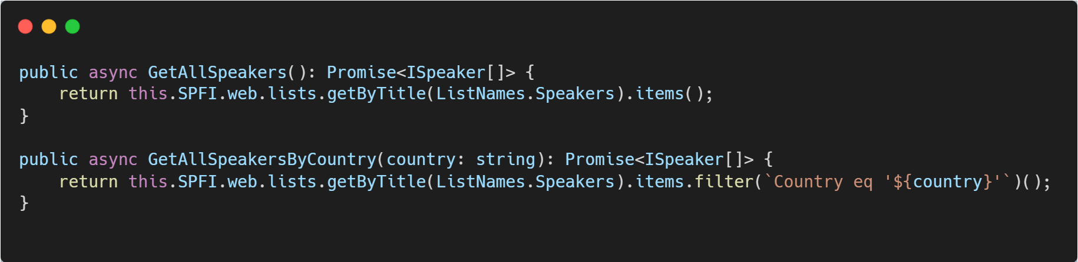
Minimizing our orange code
Notes:
This is one approach alternatives are:
“Environment variables”
Property pane configuration

Slide 25
But wait
There’s still orange code

Slide 26
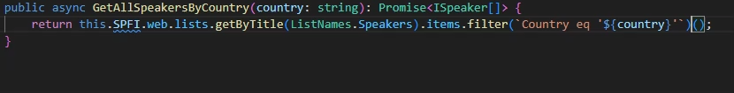
Dynamic filtering in PnPjs
Notes:
I made this out of spite of orange code
Only allows props that exist on your interface/class
Loads of supported field types
See next slide

Slide 27
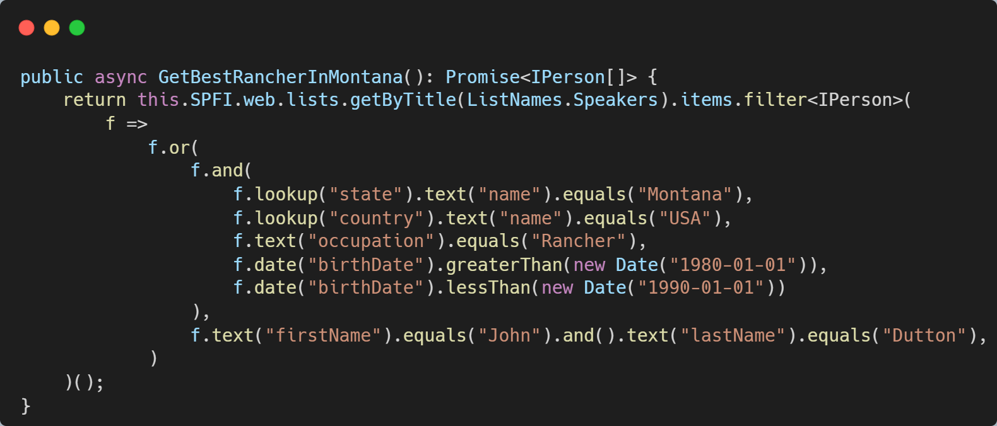
Even complex queries
((state/name eq 'Montana' and country/name eq 'USA' and occupation eq 'Rancher' and birthDate gt '1980-01-01T00:00:00.000Z' and birthDate lt '1990-01-01T00:00:00.000Z') or firstName eq 'John' and lastName eq 'Dutton')
Notes:
Nested queries
Look ups
In date range
In string array
Contains
Really any (except for Taxonomy fields)

Slide 28
Live demo
Notes:
Command + F1 to fix screen

Slide 29
Byte-Sized Brilliance
Just a bunch of random tips and tricks

Slide 30
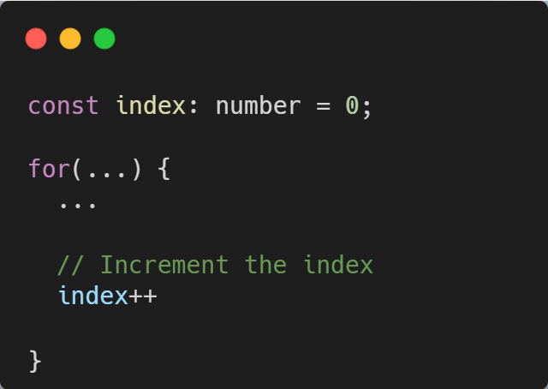
Comments
Hot take: 99% comment you’ve ever read in code are bad
Entire code blocks
They’re redundant
They lie
They rot
Are a consequence of your code not being expressive enough
Good comments
Help clarify details of the code
Serve as a warning of consequences
Notes:
You’ll often see entire code blocks that’ve been commented out because “I might need it later” … git
The number of comments that don’t add anything to the code
Comments don’t match the code, they match the expectation when said code was written
How often do you change code and forget to update the comment
Ideally your code should express what you’re trying to write in a comment
Clarify why you’re calling a beta endpoint

Slide 31
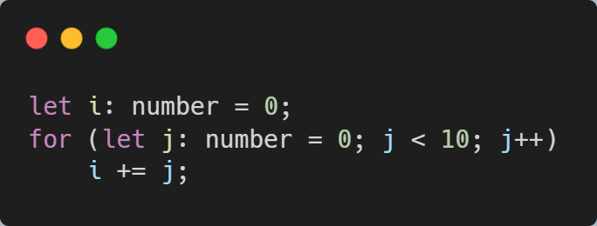
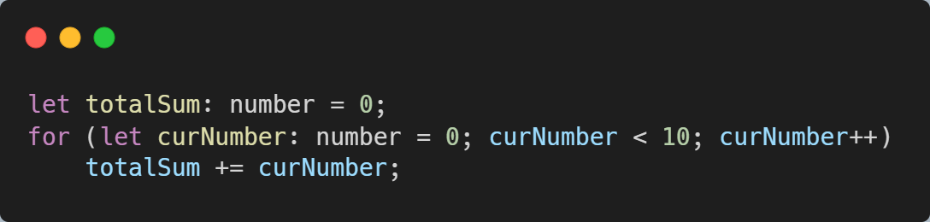
Prefer readability to “sleek” code - Meaningful names
What’s the next reader going to think?
Leave context clues for yourself
Easy as hitting F2
Notes:
Both samples to the same thing, but the bottom one reads smoother
This is a small sample, but in a very large codebase there’s a lot of Js and Is to keep track off
You could use .reduce or similar to solve this

Slide 32
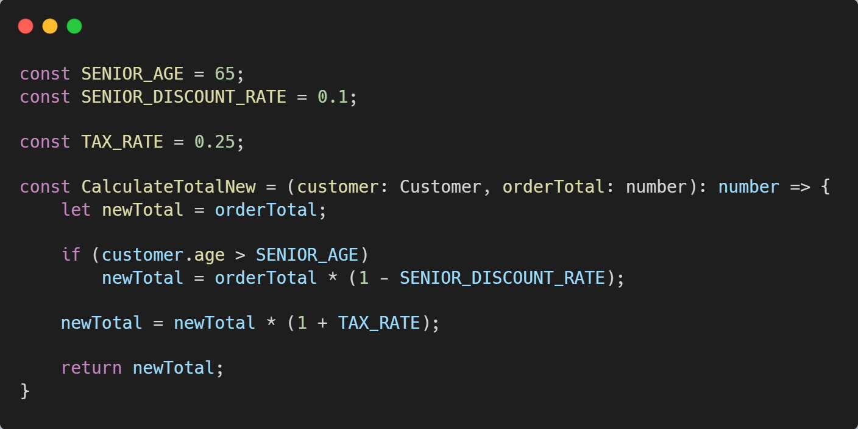
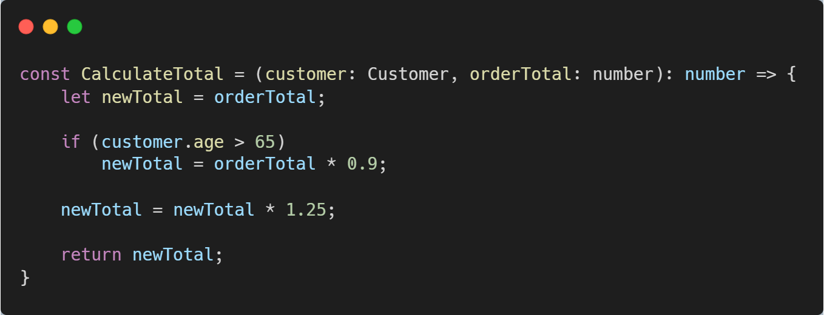
Avoid “magic numbers”
Notes:
Magic numbers will eventually lead to confusion – and requires context
VAT isn’t 25% everywhere
And my retirement age is expected to be 74, so I don’t consider 65 a senior

Slide 33
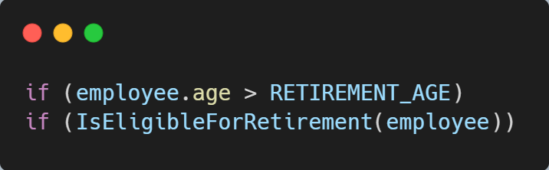
Encapsulate Conditions
A natural way to avoid comments
“Reads” better
Avoids duplication
Notes:
Arne pension – a new Danish pension system, where you can either be over the REIREMENT_AGE … or have worked for X number of years

Slide 34
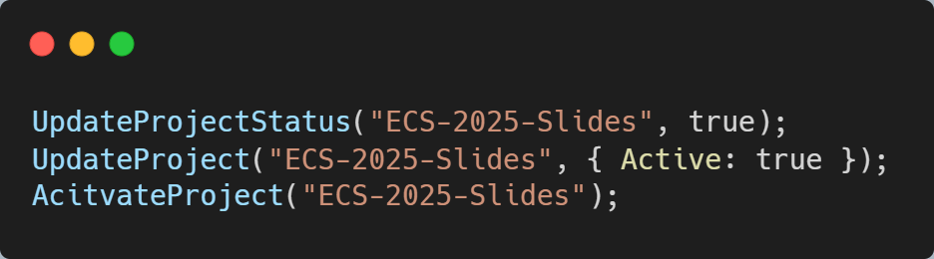
Avoid Boolean Parameters
Inside your own class, they can be fine
Without context, it can be very hard to tell what’s going on
Consider an options approach
Or simply adding more helper methods
Notes:
Hard to read without context
Using options is a great way to handle multiple options, so you don’t end up with (true, false, false, true)

Slide 35
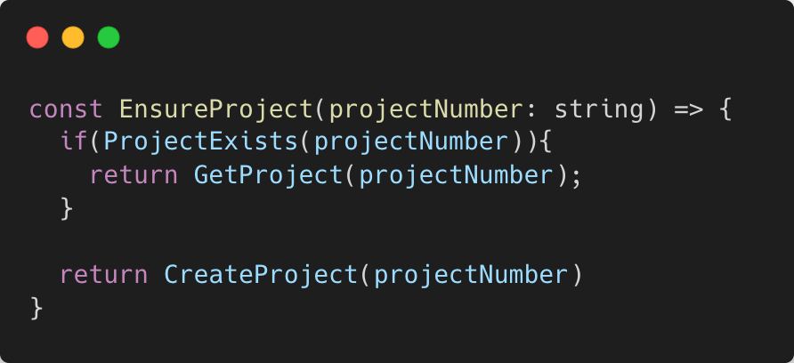
Prefer defaults to else
Else is just a “filler” here
Costs “focus” to read
Notes:
Else can cause confusion, is there another scenario?
Extra indentations and curly brackets to keep track off

Slide 36
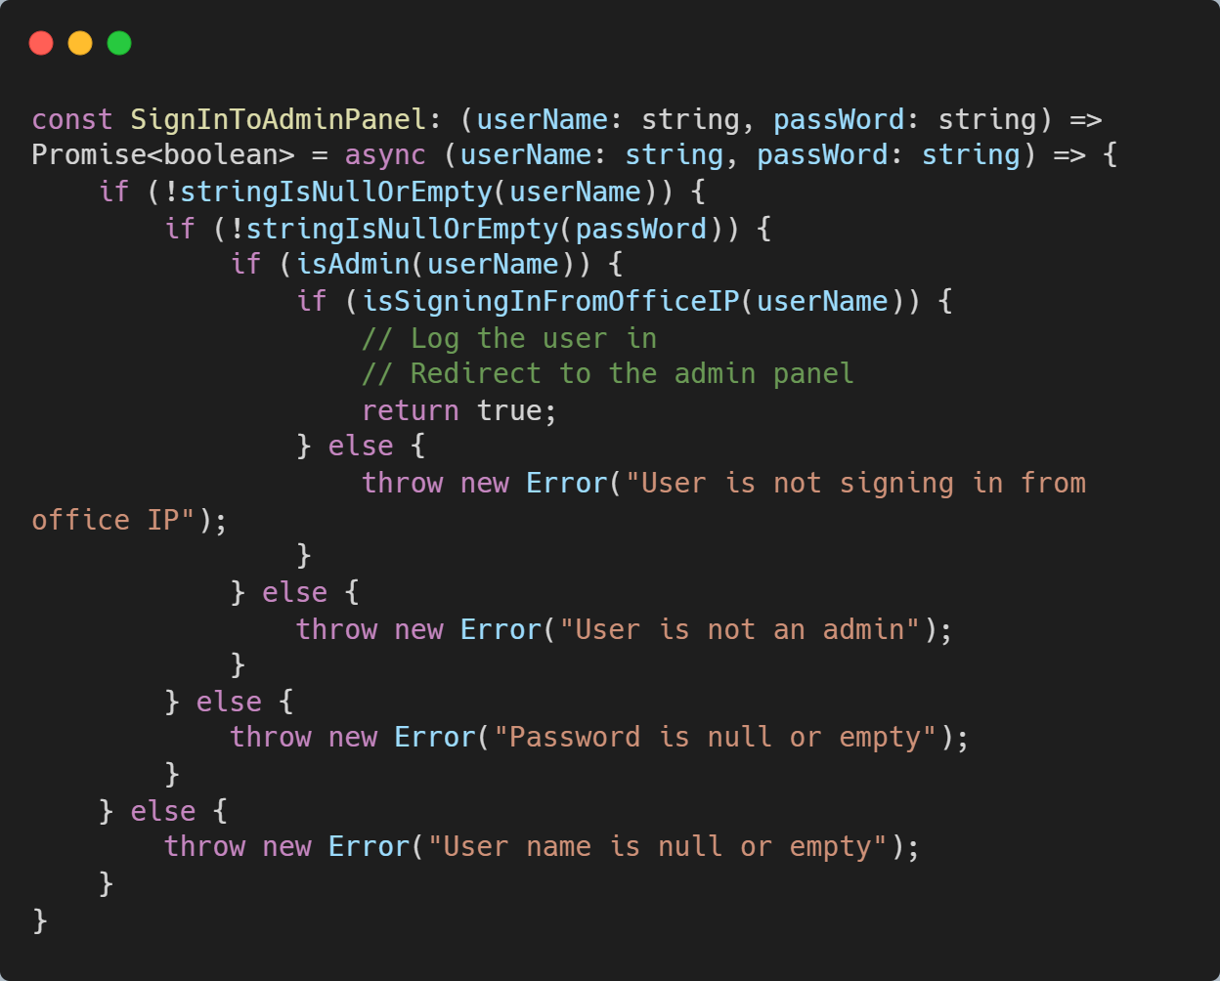
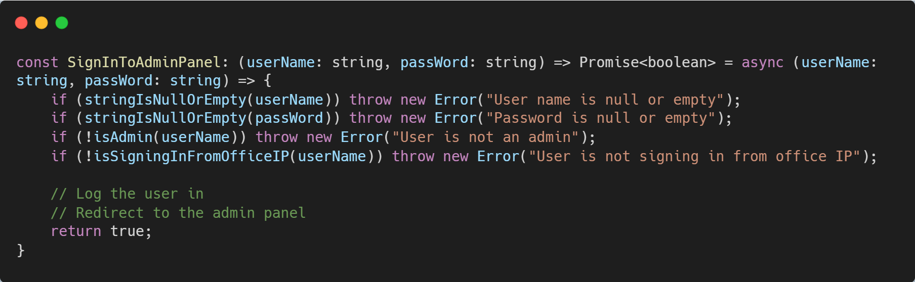
Guard clause
Notes:
Code that’s been indented more than 2 times should be refactored EVERY TIME
Way more readable, and clean, but the errors are bad, let’s fix that on the next slide

Slide 37
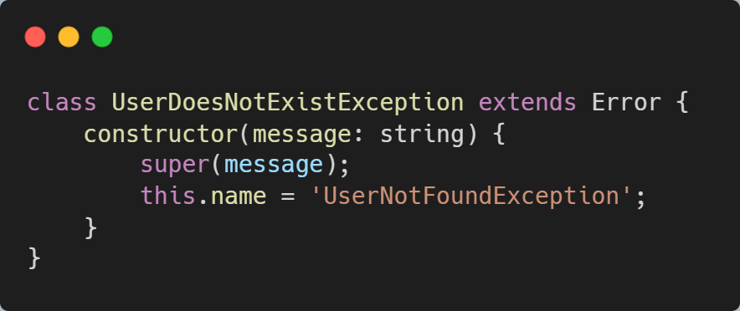
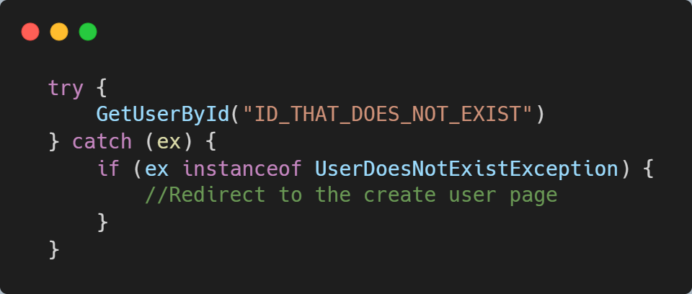
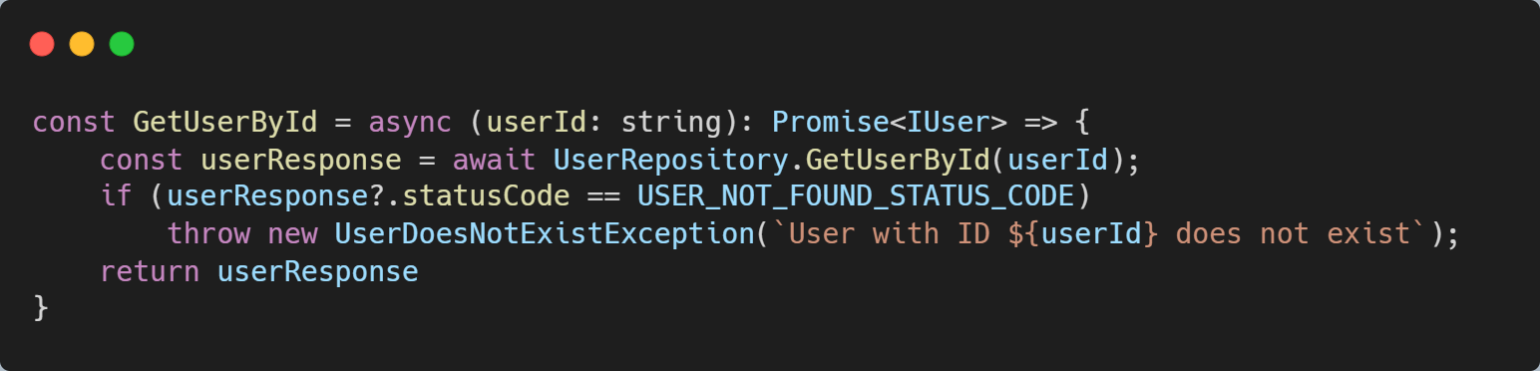
Throw specific errors
Notes:
Top left is our Exception
Buttom is the API returning an error
Top right is us catching it, using instanceof

Slide 38
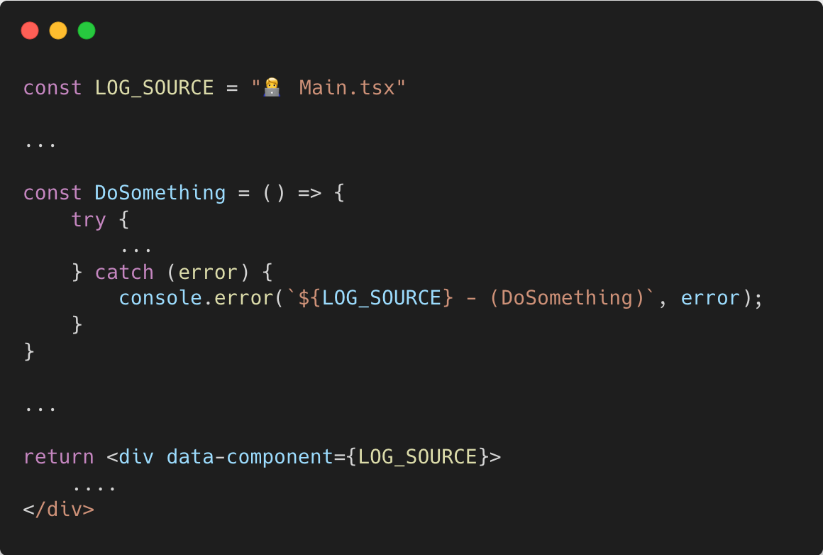
Add a log sources
Define as a single variable at the top of the file
Easily allows you to inspect your DOM
Allows you to quickly identify where an error was thrown
Use emojis … so you can blame Microsoft
Notes:
Consider starting with an emoji, or other symbol
Data-component will bleed through to the DOM, and quickly help you identify where things break

Slide 39
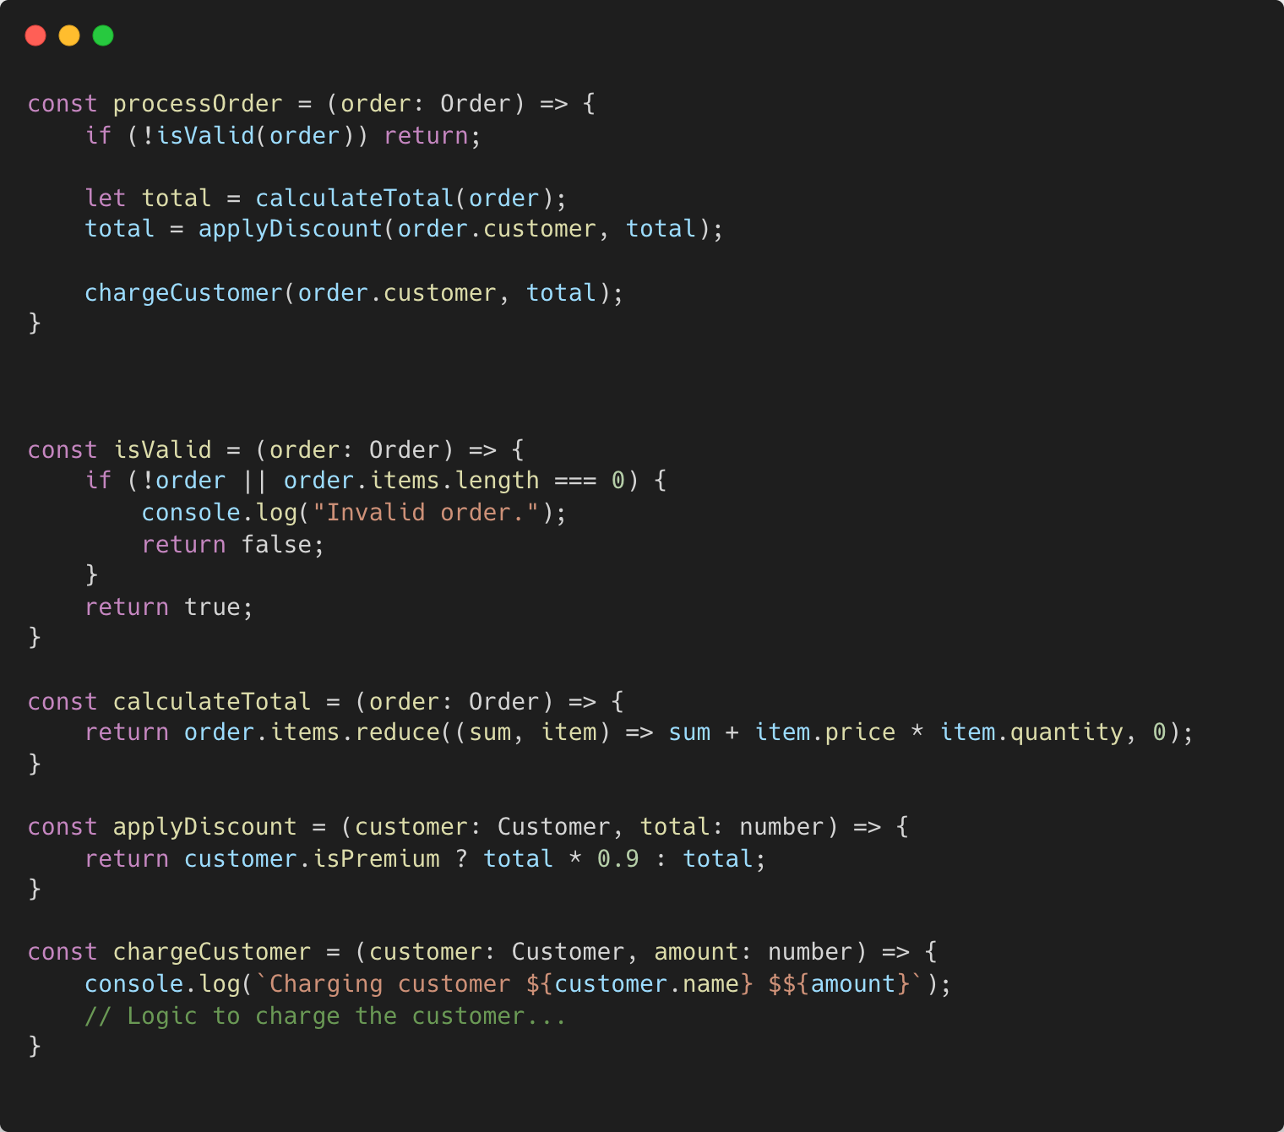
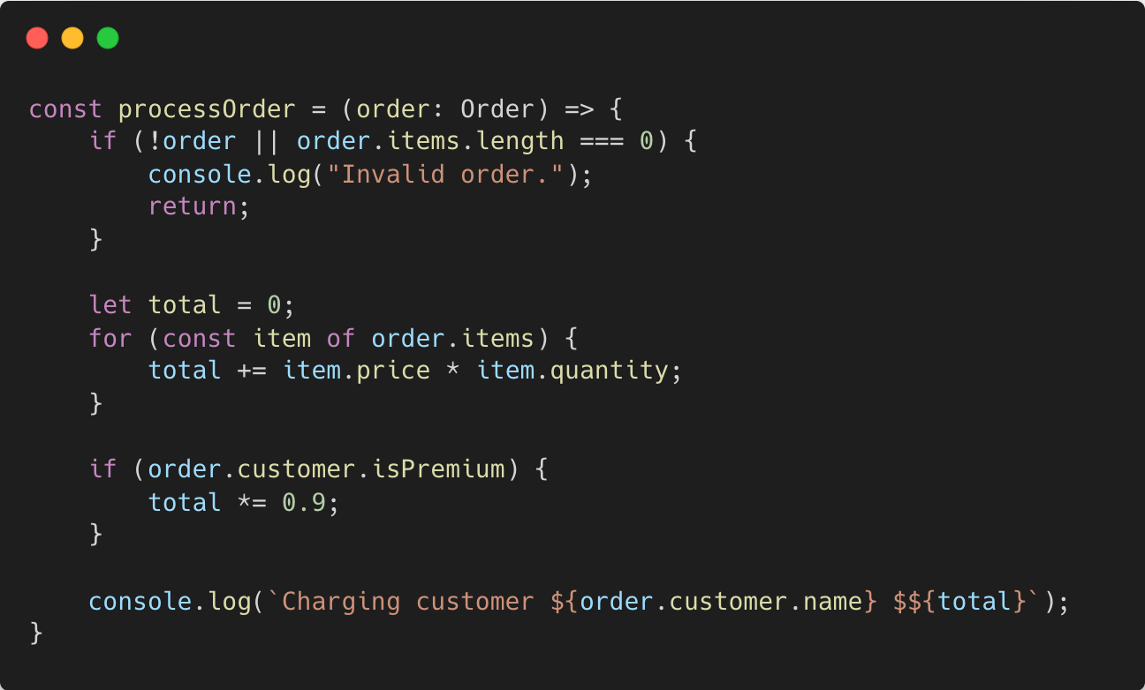
Consider splitting your functions into smaller functions
Notes:
Splitting long methods into smaller reusable segments
Increases readability
Increases reusability
Provides a faster overview

Slide 40
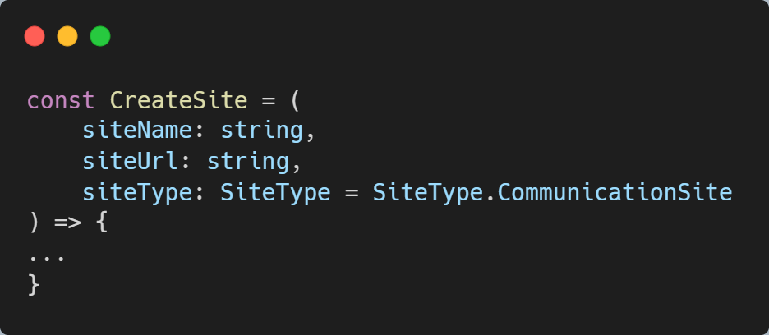
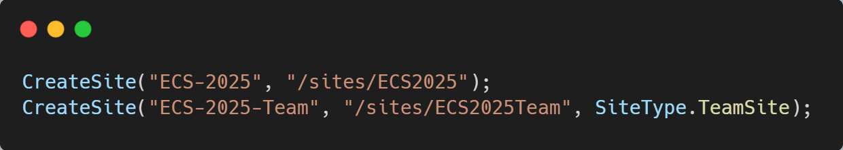
Default Parameters
Less mental overhead while keeping flexibility
Readable
Consider options object instead to minimize parameters
Notes:
Uncle Bob claims 0 parameters is the ideal amount, I don’t agree, but the less I have to look at, the better
Options are good, defaults are better

Slide 41
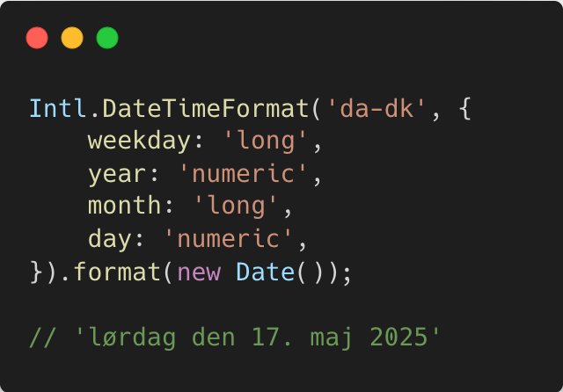
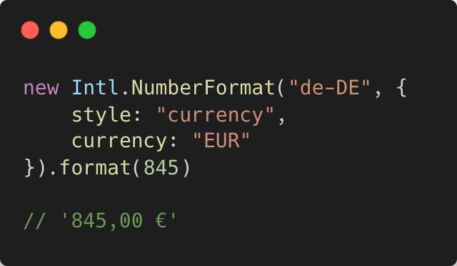
Intl
Notes:
Intl namespace – also know as internationalization
Can help you a long way with things like date formatting, numberformatting, especially when bi-lingual

Slide 42
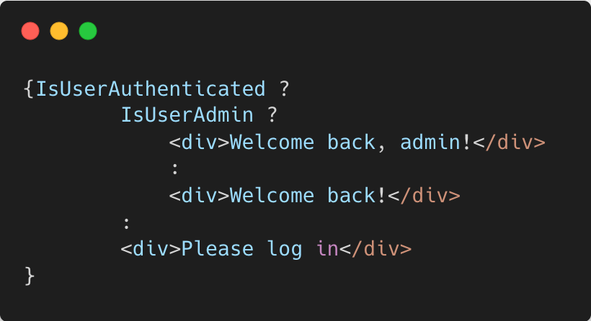
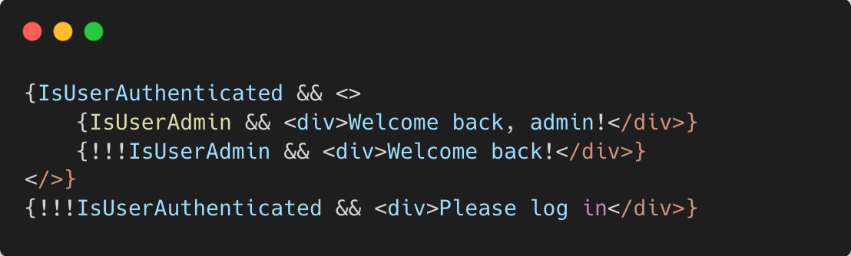
Never EVER use ternary operator in your React code
Ternary operator can “look clean”
But at the cost of being hard to change
Searching for a “:” is nearly impossible (I’m nearing 30)
Hides away the intention
NEVER EVER, NO MATTER WHAT STACK THEM
Notes:
The Ternary operator is the question mark used as an if else
They very quickly become hard to keep track off
Notice the triple !!! – this can help highlight to other devs what your intetion

Slide 43

Closing notes
Make sure you check if someone solved your problem before you
Be consistent. If you do something a certain way, do all similar things in the same way
Keep it simple stupid. Simpler is always better. Reduce complexity as much as possible.
Boy scout rule. Leave the campground cleaner than you found it.
Notes:
It’s all about how it reads 6 months down the line, when you’re no longer in the same state of mind

Slide 44


THANK YOU, YOU ARE AWESOME ❤️
PLEASE RATE THIS SESSION IN THE MOBILE APP.
Dan Toft
https://Dan-Toft.dk
https://github.com/tanddant/slides

Slide 48


Slide 51
THANK YOU, YOU ARE AWESOME ❤️
PLEASE RATE THIS SESSION IN THE MOBILE APP.
List Here Your Social Media Links, Email Address, Or Whatever You Think It Is Important :)

Slide 52
THANK YOU, YOU ARE AWESOME ❤️
PLEASE RATE THIS SESSION IN THE MOBILE APP.
List Here Your Social Media Links, Email Address, Or Whatever You Think It Is Important :)

Slide 53
THANK YOU, YOU ARE AWESOME ❤️
PLEASE RATE THIS SESSION IN THE MOBILE APP.
List Here Your Social Media Links, Email Address, Or Whatever You Think It Is Important :)

